Slide 1
Python Course for Physicists (And everyone else!) Chunk 5b: Final Words Day 1
By Jonathan Bollig
08.10.2025

Slide 2
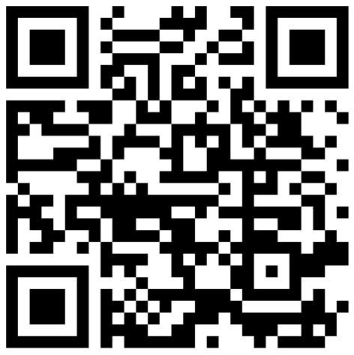
Feedback
https://vibes.fh-muenster.de/apps/live-votings/S83C1/

Slide 3
See you tomorrow 9:30 ☺

